Slide 1
GP GENIE Project Presentation
Ujin Han Ι Susan Mairs Ι Li Wang Ι Justin Florkiah Ι Roger Peterson Ι Felista Mpanga

Slide 2
Outline
Key considerations
Highlights
Selection of software development model
Parallel process in action
Method for random selection
Lessons-learned
Project summary
Notes:
Highlight: Selection of software development model
-Work in parallel the methods to validate while developing the design
Highlight: Method for random selection – Li’s arrays
-
Highlight: Trending to greater accuracy of fitness values
1) User selected percentage (10-30 %) of total population is fit enough to be parents
2) Half and half to cross over making children
3) User selected percentage (10-30%) of children get mutated
*After Testing is done: “Testing to refine inputs” as one of the highlights

Slide 3
Key Considerations
Ujin Han

Slide 4
Key considerations
Team and communications
Time
Requirements analysis
Approach to SCM
Choice of code development
Testing
Key Considerations
Highlights
Lessons-Learned
Summary
Notes:
We may have to narrow this down…

Slide 5

Team and Communications
Clearly defined roles for each member
Set ground rules and expectations for performance
Determined preferred method of communication
Key Considerations
Highlights
Lessons-Learned
Summary

Slide 6

Time
Limited time frame
Limited available time to meet
Short time frame to adjust to the requirements change
Key Considerations
Highlights
Lessons-Learned
Summary

Slide 7
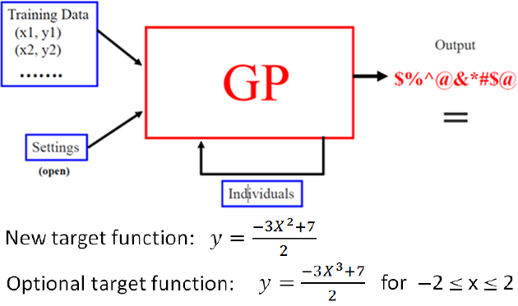
Requirements Analysis
Set goals and objectives for the project
Guide to what is needed in the final product
Take future change in requirements into account
Key Considerations
Highlights
Lessons-Learned
Summary
Notes:
Susan’s Notes:
Reduced ambiguity of expected result
Provided visual tools for team to grasp vision
Set groundwork of design for software
Allowed for development of our own code

Slide 8



Approach to SCM Model
Multi-user friendly
Real-time updating and tracking
From Google Drive to GitHub
Key Considerations
Highlights
Lessons-Learned
Summary

Slide 9
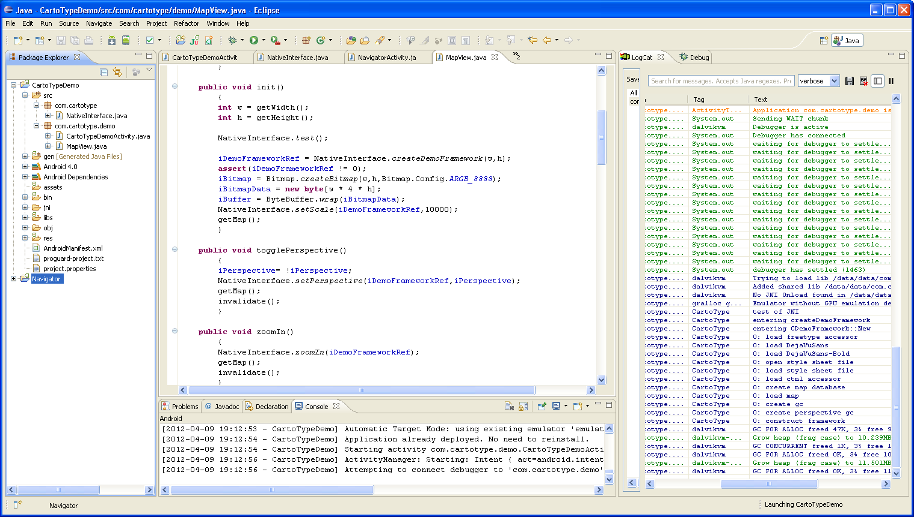
Choice of Code Development
Flexibility with future change in requirements
Members with experience in developing code
Custom solution and utmost control
Key Considerations
Highlights
Lessons-Learned
Summary
Notes:
Nothing extra to distract or complicate
Custom solutions to our desired design direction
Utmost control
Best way to learn about the development process
Best to design tests for
Easiest model for verification

Slide 10
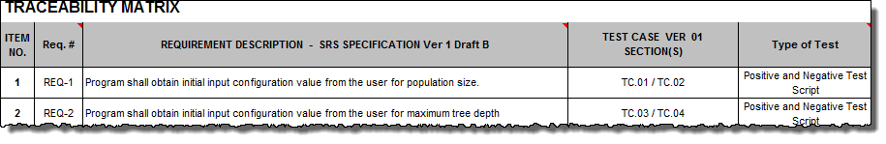
Testing
Branch testing – Negative and Positive
Unit testing – Cycle test
Integration and system testing
Code Review – Requirement met by verification
Key Considerations
Highlights
Lessons-Learned
Summary

Slide 11
Highlights
Roger Peterson, Susan Mairs, Li Wang

Slide 12
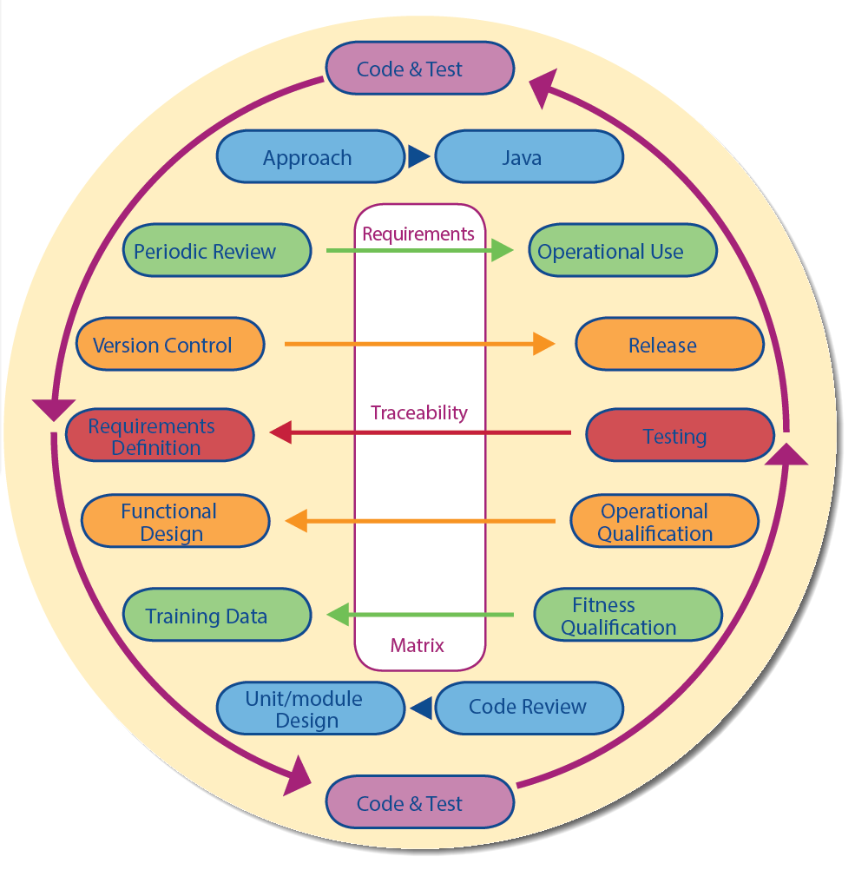
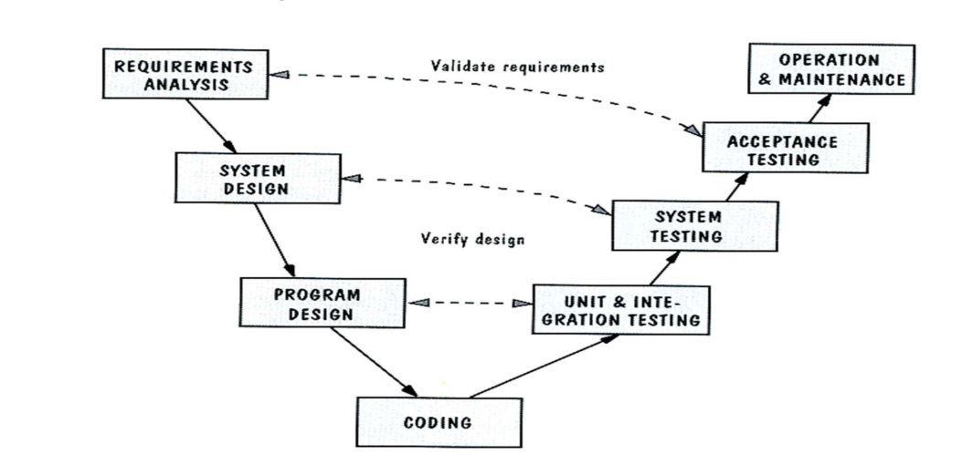
Selection of Software Development Model
Careful consideration to all the models
Criteria:
Work in parallel to validate while developing the code
Provides most flexibility and change towards the end
Key Considerations
Highlights
Lessons-Learned
Summary

Slide 13
SCM: Version Control
Change Management
Requirements
Development
Test Planning
Test Execution
Design
Develop
Trace to requirements
Assign
Prioritize
Monitor
Unit
Integration
Analyze
Defect Management
Review
Prioritize
Resolve
Verify
Key Considerations
Highlights
Lessons-Learned
Summary
Notes:
Custom animation effects: motion paths with auto-reverse, varying speeds
(Advanced)
To reproduce the shape effects on this slide, do the following:
On the Home tab, in the Slides group, click Layout, and then click Blank.
On the Home tab, in the Drawing group, click Shapes, and then under Rectangles, select Rectangle (first option from the left). On the slide, drag to draw the first rectangle.
Select the rectangle. Under Drawing Tools, on the Format tab, in the Size group, do the following:
In the Shape Height box, enter 0.86”.
In the Shape Width box, enter 10.5”.
Under Drawing Tools, on the Format tab, in the Shape Styles group, click the Format Shape dialog box launcher. In the Format Shape dialog box, in the left pane, click Fill. In the Fill pane, click Solid fill, and then do the following:
Click the button next to Color, and click More Colors. In the Colors dialog box, on the Custom tab, enter values for Red: 86, Green: 113, Blue: 118.
In the Transparency box, enter 40%.
Also in the Format Shape dialog box, in the left pane, click Line Color, and then in the Line Color pane, click No line.
Select the rectangle. On the Home tab, in the Clipboard group, click the arrow under Paste, and then click Duplicate.
Select the duplicate rectangle. Under Drawing Tools, on the Format tab, in the Size group, do the following:
In the Shape Height box, enter 0.86”.
In the Shape Width box, enter 4.96”.
Under Drawing Tools, on the Format tab, in the Shape Styles group, click the Format Shape dialog box launcher. In the Format Shape dialog box, in the left pane, click Fill. In the Fill pane, select Solid fill. Click the button next to Color, and then under Theme Colors select Red, Accent 2, Darker 50% (sixth row, sixth option from the left). In the Transparency box, enter 40%.
Press and hold SHIFT and select both rectangles. On the Home tab, in the Drawing group, click Arrange, point to Align, and then do the following:
Click Align to Slide.
Click Align Center.
Click Align Middle.
To reproduce the animation effects for the second rectangle on this slide, do the following:
Select the second rectangle (smaller, red). On the Animations tab, in the Animations group, click Custom Animation. (Note: For this animation effect, the first (largest, blue) rectangle remains stationary on the slide.)
In the Custom Animation task pane, click Add Effect, point to Motion Paths, and then click Right.
On the slide, select motion path endpoint (red arrow), and drag the end of the path beyond the right edge of the slide. Select the motion path starting point (green arrow), and drag the starting point of the path beyond the left edge of the slide.
In the Custom Animation task pane, click the motion path animation effect, and then under Modify: Right, in the Start list, select With Previous.
Also in the Custom Animation task pane, click the arrow next to the motion path animation effect, and click Effect Options. In the Right dialog box, do the following:
On the Effect tab, under Settings, select Auto-Reverse.
On the Timing tab, in the Speed box, enter 3.55 seconds, and then in the Repeat list, select Until End of Slide.
To reproduce the animation effects for the third rectangle on this slide, do the following:
Select the second (small, red) rectangle.
On the Home tab, in the Clipboard group, click the arrow under Paste, click Duplicate, and then drag the new rectangle (along with the new motion path) above the other rectangles. Repeat this step three more times until there is a total of six rectangles (including the original two).
Select the third rectangle. Under Drawing Tools, on the Format tab, in the Size group, do the following:
In the Shape Height box, enter 0.86”.
In the Shape Width box, enter 3.16”.
Under Drawing Tools, on the Format tab, in the Shape Styles group, click the Format Shape dialog box launcher. In the Format Shape dialog box, in the left pane, click Fill. In the Fill pane, click Solid fill, and then do the following:
Click the button next to Color, and then click More Colors. In the Colors dialog box, on the Custom tab, enter values for Red: 79, Green: 129, Blue: 189.
In the Transparency box, enter 40%.
On the Animations tab, in the Animations group, click Custom Animation. In the Custom Animation task pane, click the third rectangle motion path animation effect, and then under Modify: Right, in the Start list, select With Previous.
Also in the Custom Animation task pane, click the arrow next to the third rectangle motion path animation effect, and then click Effect Options. In the Effect Options dialog box, do the following:
On the Effect tab, under Settings, select Auto-Reverse.
On the Timing tab, in the Repeat list, select Until End of Slide, and in the Speed box, enter 3.1 seconds.
On the slide, position the third rectangle on the first (and longest) rectangle, lining up the top and bottom edges.
To reproduce the animation effects for the fourth rectangle on this slide, do the following:
Select the fourth rectangle. Under Drawing Tools, on the Format tab, in the Size group, do the following:
In the Shape Height box, enter 0.86”.
In the Shape Width box, enter 1.68”.
Under Drawing Tools, on the Format tab, in the Shape Styles group, click the Format Shape dialog box launcher. In the Format Shape dialog box in the left pane, click Fill. In the Fill pane, click Solid fill, and then do the following:
Click the button next to Color, and then under Theme Colors click Olive Green, Accent 3, Darker 50% (sixth row, seventh option from the left).
In the Transparency box, enter 40%.
On the Animations tab, in the Animations group, click Custom Animation. In the Custom Animation task pane, select the fourth rectangle motion path animation effect, and under Modify: Right, in the Start box, select With Previous.
Also in the Custom Animation task pane, click the arrow next to the fourth rectangle motion path animation effect, and then click Effect Options. In the Effect Options dialog box, do the following:
On the Effect tab, under Settings, select Auto-Reverse.
On the Timing tab, in the Repeat list, select Until End of Slide, and in the Speed box, enter 3.95 seconds.
On the slide, position the fourth rectangle on the first (and longest) rectangle, lining up the top and bottom edges.
To reproduce the animation effects for the fifth rectangle on this slide, do the following:
Select the fifth rectangle. Under Drawing Tools, on the Format tab, in the Size group, do the following:
In the Shape Height box, enter 0.86”.
In the Shape Width box, enter 1.5”.
Under Drawing Tools, on the Format tab, in the Shape Styles group, click the Format Shape dialog box launcher. In the Format Shape dialog box in the left pane, click Fill. In the Fill pane, click Solid fill, and then do the following:
Click the button next to Color, and then click More Colors. In the Colors dialog box, on the Custom tab, enter values for Red: 127, Green: 140, Blue: 60.
In the Transparency box, enter 40%.
On the Animations tab, in the Animations group, click Custom Animation. In the Custom Animation task pane, select the fifth rectangle motion path animation effect, and then under Modify: Right, in the Start list, select With Previous.
Also in the Custom Animation task pane, click the arrow next to the fifth rectangle motion path animation effect, and then click Effect Options. In the Effect Options dialog box, do the following:
On the Effect tab, under Settings, select Auto-Reverse.
On the Timing tab, in the Repeat list, select Until End of Slide, and in the Speed box, enter 5.3 seconds.
On the slide, position the fifth rectangle on the first (and longest) rectangle, lining up the top and bottom edges.
To reproduce the animation effects for the sixth rectangle on this slide, do the following:
Select the sixth rectangle. Under Drawing Tools, on the Format tab, in the Size group, do the following:
In the Shape Height box, enter 0.86”.
In the Shape Width box, enter 0.98”.
Under Drawing Tools, on the Format tab, in the Shape Styles group, click the Format Shape dialog box launcher. In the Format Shape dialog box in the left pane, click Fill. In the Fill pane, click Solid fill, and then do the following:
Click the button next to Color, and then under Theme Colors click Olive Green, Accent 3, Darker 25% (fifth row, seventh option from the left).
In the Transparency box, enter 40%.
On the Animations tab, in the Animations group, click Custom Animation. In the Custom Animation task pane, select the sixth rectangle motion path animation effect, and under Modify: Right, in the Start box, select With Previous.
Also in the Custom Animation task pane, click the arrow next to the sixth rectangle motion path animation effect, and then click Effect Options. In the Effect Options dialog box, do the following:
On the Effect tab, under Settings, select Auto-Reverse.
On the Timing tab, in the Repeat list, select Until End of Slide, and in the Speed box, enter 4.2 seconds.
On the slide, position the sixth rectangle on the first (and longest) rectangle, lining up the top and bottom edges.
To reproduce the background effects on this slide, do the following:
Right-click the slide background area, and then click Format Background. In the Format Background dialog box, click Fill in the left pane, select Gradient fill in the right pane, and then do the following:
In the Type list, select Radial.
Click the button next to Direction, and then click From Center (third option from the left).
Under Gradient stops, click Add or Remove until two stops appear in the drop-down list.
Also under Gradient stops, customize the gradient stops that you added as follows:
Select Stop 1 from the list, and then do the following:
In the Stop position box, enter 40%.
Click the button next to Color, and then under Theme Colors click Black, Text 1, Lighter 50% (second row, second option from the left).
Select Stop 2 from the list, and then do the following:
In the Stop position box, enter 100%.
Click the button next to Color, and then under Theme Colors click Black, Text 1 (first row, second option from the left).

Slide 14

Parallel Process in Action
Requirements and design with development
Analyst, process team, developer active
Code – Code – Code
Prep – Review – Prep Iterations
Code with unit and system testing
Demos
Unit testing
Output to test tools
Key Considerations
Highlights
Lessons-Learned
Summary
Notes:
Requirements and Design with Development
Requirements with early code POCs
Data Flow Analysis with Algorithm Development
Object Models with Java Class Development
Code – Code - Code
Verification via walkthroughs
Requirements trace matrix
Test Plan and script development
Test Materials Development from Test Runs
Code with Unit and System Testing
Demonstrations of working code parts
Internal unit testing for verification
Output to external tools for system validation

Slide 15
Method for Random Selection
For cross over: randomly selected arrays
For mutation: randomly selected parent and/or children
Error handling
Key Considerations
Highlights
Lessons-Learned
Summary

Slide 16
Lessons-Learned
Felista Mpanga

Slide 17

What Worked
Building Our Own Code
Team Review
Weekly Team Meetings
Strong Lead in Each Section
Key Considerations
Highlights
Lessons-Learned
Summary

Slide 18

What Didn’t Work
Time for Tool and Test Environment Set Up
Delay in Parallel Testing
Key Considerations
Highlights
Lessons-Learned
Summary

Slide 19
Project Summary
Justin

Slide 20
Project Summary
The objective of the project
Team-analysis
Analyzing what happened during the project
Lessons-Learned
Project outcomes
Key Considerations
Highlights
Lessons-Learned
Summary

Slide 21
Assignment #10
Roger Peterson

Slide 22
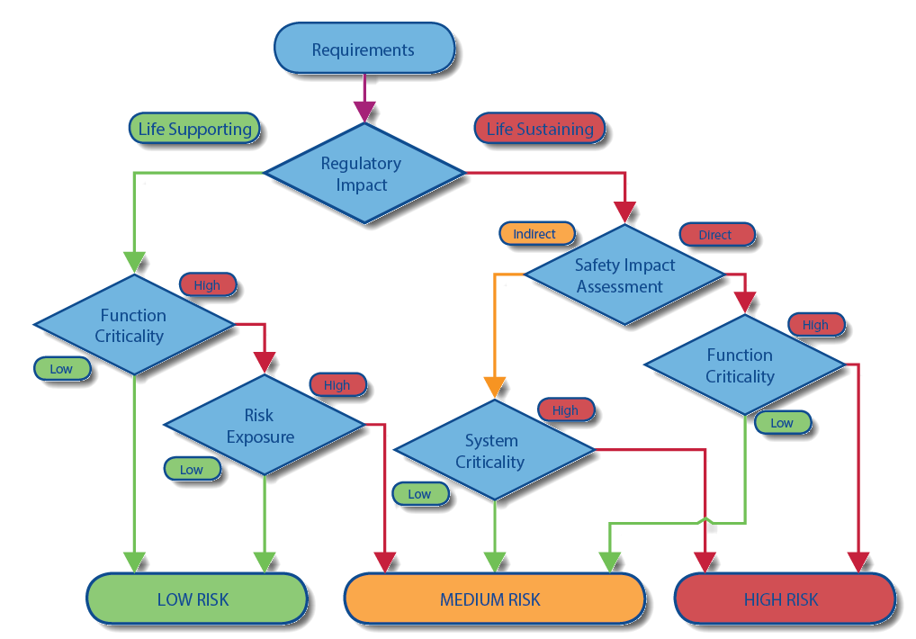
Test Plan Assessment
Identifying, mitigating and minimizing potential hazards
Evaluate criticality by virtue of design
Rationalization based on level of Risk
“Cell Show”
“H-Monitor”
“Read Me”

Slide 23
Test Plan Synopsis
Basis on cyclomatic complexity
System Integration testing
Hardware and software

